Slide 1
Cluster Evaluation

Slide 2
Internal Measures: Cohesion and Separation
A proximity graph based approach can be used for cohesion and separation.
Cluster cohesion is the sum of the weight of all links within a cluster.
Cluster separation is the sum of the weights between nodes in the cluster and nodes outside the cluster.
cohesion
separation

Slide 3
Internal Measures: Silhouette Coefficient
Silhouette Coefficient combine ideas of both cohesion and separation, but for individual points, as well as clusters and clusterings
For an individual point, i
Calculate a = average distance of i to the points in its cluster
Calculate b = min (average distance of i to points in another cluster)
The silhouette coefficient for a point is then given by s = 1 – a/b if a < b, (or s = b/a - 1 if a ≥ b, not the usual case)
Varies between -1 and 1.
The closer to 1 the better.
Can calculate the Average Silhouette coefficient for a cluster or a clustering

Slide 4
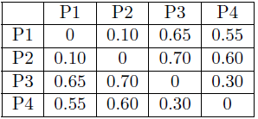
Example
Using the distance matrix in the following table, compute the
silhouette coefficient for each point
Cluster 1: {P1, P2}
Cluster 2: {P3, P4}

Slide 5
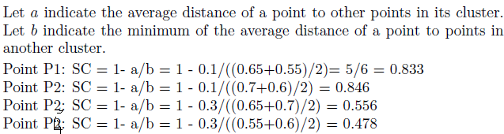
Example
Using the distance matrix in the following table, compute the
silhouette coefficient for each point
Cluster 1: {P1, P2}
Cluster 2: {P3, P4}

Slide 6
Example
Using the distance matrix in the following table, compute the
silhouette coefficient for each point and each of the two clusters
Cluster 1: {P1, P2}
Cluster 2: {P3, P4}

Slide 7

Example
Using the distance matrix in the following table, compute the
silhouette coefficient for each point and each of the two clusters
Cluster 1: {P1, P2}
Cluster 2: {P3, P4}

Slide 8
Example
Using the distance matrix in the following table, compute the
silhouette coefficient for each point, each of the two clusters,
and overall clustering
Cluster 1: {P1, P2}
Cluster 2: {P3, P4}

Slide 9
Example
Using the distance matrix in the following table, compute the
silhouette coefficient for each point, each of the two clusters,
and overall clustering
Cluster 1: {P1, P2}
Cluster 2: {P3, P4}

Slide 10
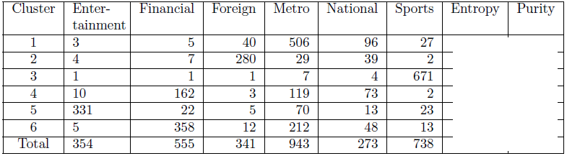
Classification-oriented measures
Calculate Entropy, purity, precision, recall, F-score of each of
the clusters above.

Slide 11
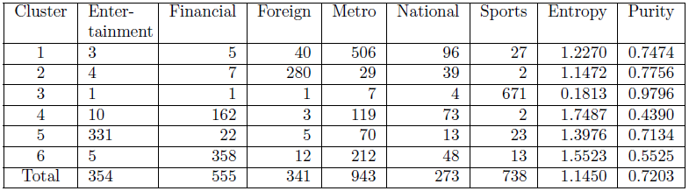
Classification-oriented measures

Slide 12
Classification-oriented measures
What is the precision and recall of Cluster-1 wrt Metro class

Slide 13
Classification-oriented measures
What is the precision and recall of Cluster-1 w.r.t. Metro class
Precision = 0.74
Recall = 0.53

Slide 14
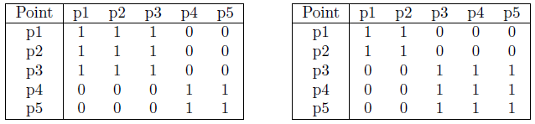
Similarity-oriented measures
Correlation, Rand statistic, Jaccard statistic

Slide 15
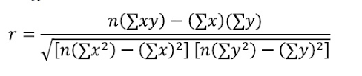
Similarity-oriented measures
Correlation, Rand statistic, Jaccard statistic
Correlation between the two matrices=?

Slide 16
Similarity-oriented measures
Correlation, Rand statistic, Jaccard statistic
Correlation between the two matrices=0.359

Slide 17
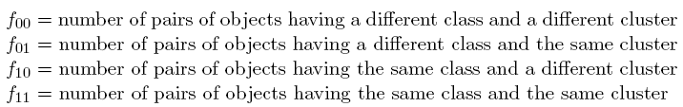
Similarity-oriented measures
Example: Correlation, Rand statistic, Jaccard statistic

Slide 18
Similarity-oriented measures
Example: Correlation, Rand statistic, Jaccard statistic

Slide 19


Similarity-oriented measures
Example: Correlation, Rand statistic, Jaccard statistic

Slide 20
Thank You!

